Slide 1
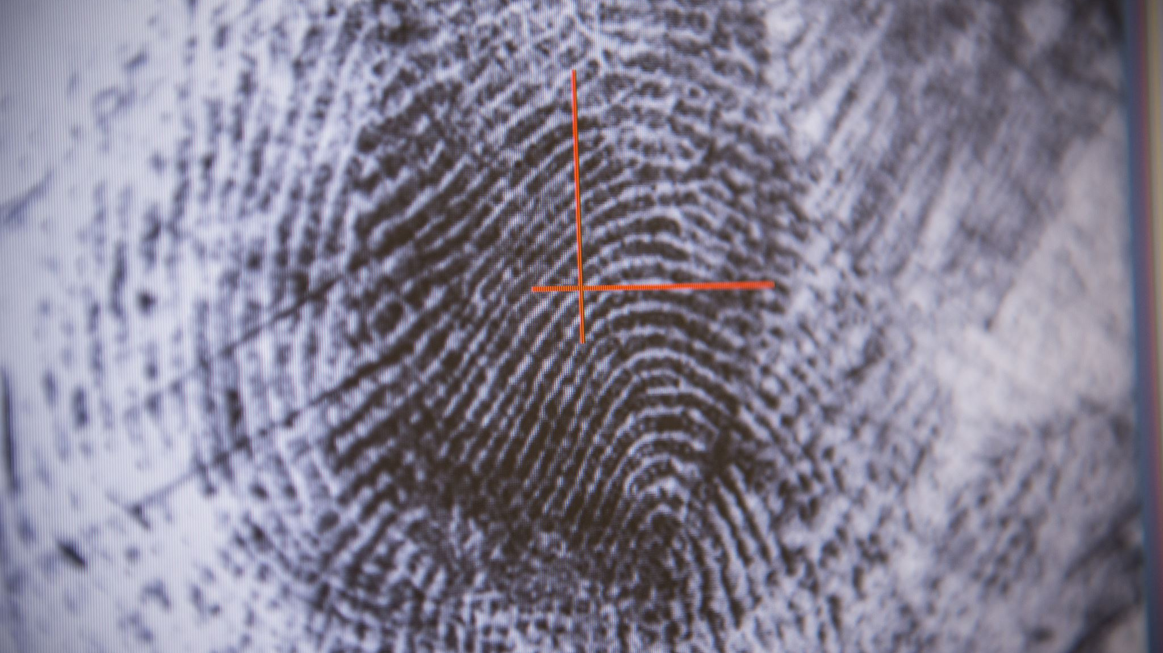
Deep Fake Image Detection System AI Agents for Defense & Gov Hackathon
15 November 2024
Sara Hekmaty, Terrell Davis, Bonassa Teizazu, Vishnavi Chennu

Slide 2

Problem Statement
Deepfake images, powered by advanced AI techniques like GANs, pose an escalating threat to U.S. intelligence operations. These hyper-realistic forgeries are increasingly used by adversaries to spread misinformation, disrupt decision-making, and undermine trust in critical intelligence.
Misinformation Campaigns: Deepfakes enable adversaries to fabricate evidence, manipulate public opinion, and destabilize geopolitical relations.
Operational Security Risks: Synthetic media can impersonate individuals, compromise covert operations, and exploit vulnerabilities in intelligence workflows.
Detection Difficulties: Advancing deepfake technology reduces detectable artifacts, while the sheer volume of digital content strains existing monitoring capabilities.
Why It Matters
National Security: Deepfakes erode trust in intelligence assessments and may be weaponized in disinformation campaigns by nation-state actors.
Strategic Response: Developing robust AI-driven detection tools is essential for safeguarding the integrity of intelligence operations and countering adversarial tactics.

Slide 3
Deepfake Image Detection System
Modular Framework:
Train Module: Preprocesses labeled datasets of authentic and manipulated images, leveraging state-of-the-art machine learning models to learn subtle differences between real and deepfake content.
Test Module: Evaluates the trained model's performance on unseen data, ensuring high accuracy and robustness across diverse deepfake techniques.
Verify Module: Validates the model's ability to generalize by providing a confidence score for authenticity when applied to new images.
Post-Training Functionality:
Image Analysis: Load single or multiple images for assessment.
Confidence Scoring: Generate a detailed confidence score indicating the likelihood of an image being a deepfake.
Scalability: Process large datasets efficiently for operational use in high-stakes scenarios.
How It Works
Data Preprocessing:
Utilizes advanced algorithms to extract critical features from input images.
Applies forensic techniques to detect inconsistencies in texture, lighting, and metadata.
Training Pipeline:
Combines convolutional neural networks (CNNs) for image analysis and auxiliary data processing for metadata.
Uses labeled datasets to learn patterns unique to deepfake images.
Evaluation Metrics:
Achieves high precision and recall rates, minimizing false positives and negatives.
Outputs are validated against real-world scenarios to ensure reliability.
Deployment:
Deployable on local and cloud platforms for rapid field use.
Intuitive interface for intelligence analysts to upload images and interpret confidence scores.

Slide 4
Recommendations / Next Steps
1. Leverage Highly Curated Deepfake Datasets
Utilize datasets tailored to deepfake detection to improve model accuracy and robustness.
Include a variety of manipulation techniques to ensure comprehensive training coverage.
2. Enhance Image Interpretation with Computer Vision and Face Recognition
Combine YOLO or AWS Rekognition for object detection with FaceNet or Dlib for high-accuracy face recognition.
Use OpenCV for preprocessing tasks such as image resizing, denoising, or edge detection before applying deep learning models.
Leverage Vision Transformers (ViT) or ResNet to improve detection accuracy for complex scenarios involving deepfakes.
Assign a "Relevancy Score", highlighting the image's importance to the intelligence community.
3. Apply Sentiment Analysis to Associated Text
Analyze accompanying text (e.g., captions, comments) to assess sentiment.
Generate a "Sentiment Score" categorizing content as positive, neutral, or hostile.
4. Develop a Risk Assessment Dashboard
Create a unified dashboard combining the following weighted scores:
Confidence Score: Likelihood of the image being a deepfake.
Relevancy Score: Strategic importance based on face recognition.
Sentiment Score: Hostility or intent of associated text.
Weight scores to compute an "Overall Risk Score" for prioritizing potential threats.
Enable automated alerts, workflows, and human review for high-risk cases.

